Slide 1
Scrambled Speech Update
8-12-2024

Slide 2
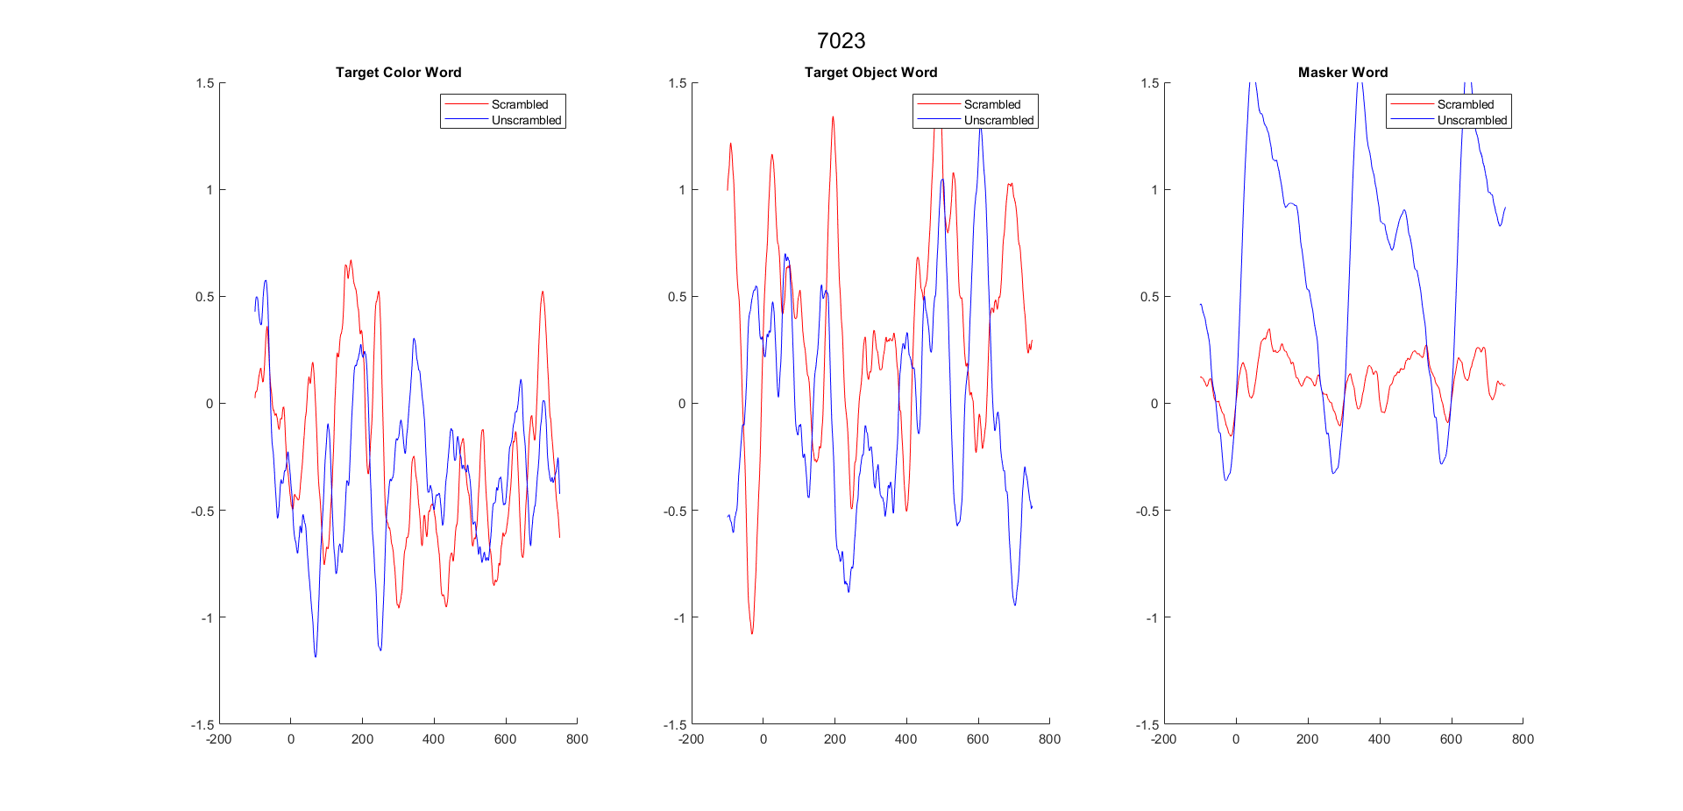
Stepping thru all trials (7023)

Slide 3
Condition by Condition (7023)

Slide 4
Stepping thru all trials (7024)

